Slide 1
In the production line
New chemical
DSA-6300
Igor Ostaptchenko

Slide 2
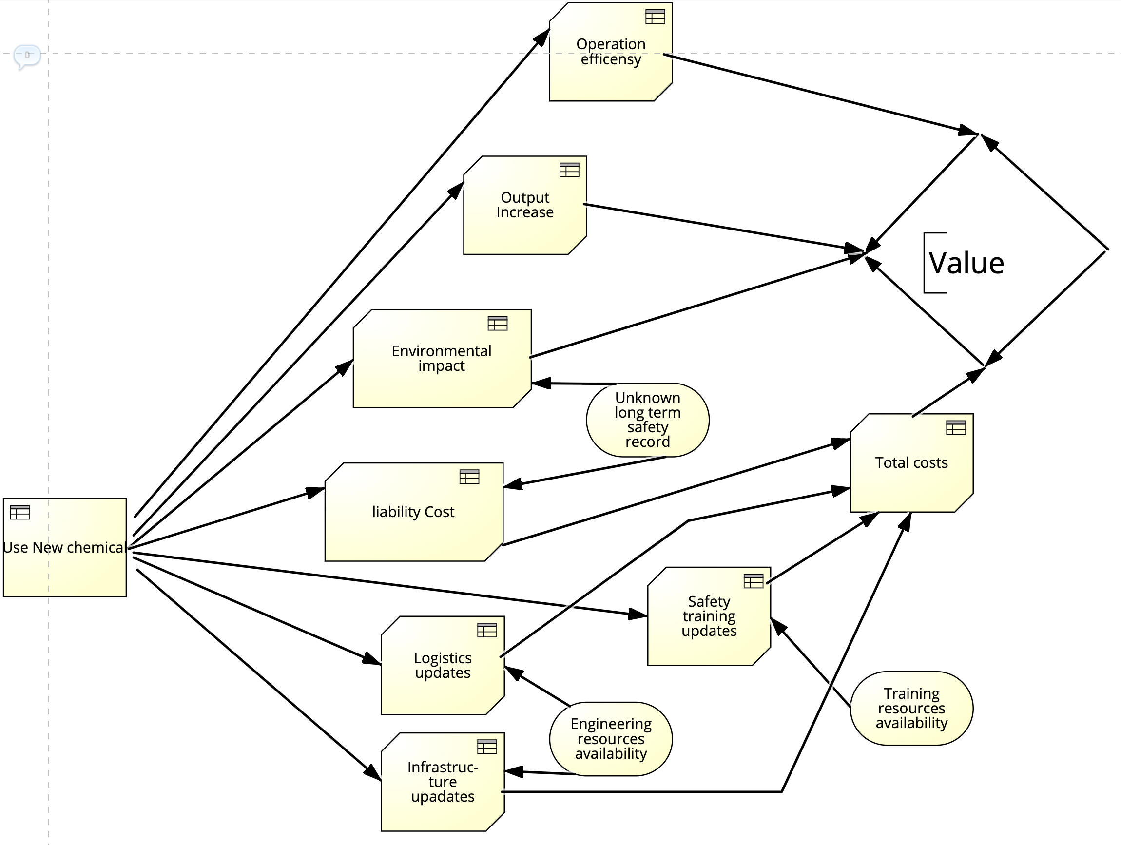

Slide 3
The decision to use new chemical as new material for the production line.
The known impact may include increased operational efficiencies and increase of the production output.
The cost is impacted by necessary logistical adjustments and infrastructure updates required to make use of new material possible. The logistical and infrastructure updates are impacted by potentially unknown availability of engineering resources to design, test and execute the updates.

Slide 4
The decision to use new chemical as new material for the production line.
The unknown longterm environmental impact and human safety track record impacts the value directly.
The potentially negative impact on environment and people safety may drive up the liability cost.
The safety training may be impacted by availability of educators.

